Slide 1
Digital Portfolio
STUDENT NAME: VARALAKSHMI S
REGISTER NO AND NMID:24132030500122037
DEPARTMENT: BCA(2nd year)
COLLEGE: SRI ARAVINDAR ART AND SCIENCE COLLEGE AFFILIATED BY ANNAMALAI UNIVERSITY

Slide 2
PROJECT TITLE DIGITAL PORTFOLIO:-
The project is a simple online portfolio for VARALAKSHIMI S. The website introduces VARALAKSHIMI,show he skills(like python,HTML,css,ect...),display her certificates,and mention his interests in sports such as karate.
KEY SECTION:-
Introdution and cv download
About me (eduction and interests)
Skills displayed with icons
Certificate with detials
5. Sports interestes
6. cotact information(email,whatsapp,github)
This fortfolio is useful to share her profile,achivement and contact detials

Slide 3


AGENDA
Problem Statement
Project Overview
End Users
Tools and Technologies
Portfolio design and Layout
Features and Functionality
Results and Screenshots
Conclusion
Github Link
3/21/2024 Annual Review

Slide 4

PROBLEM STATEMENT:-
Student often stuggle to present their skills,achivement,and projects in a professional manner.
Traditional resumes are static and lack interactivity.A personal portfolio website helps in showcasing technical skill, certificates and extracurricular activities dynamically,incresing opporunities for internships and jobs.

Slide 5

PROJECT OVERVIEW:-
This project is a personal portfolio website developed for Varalakshmi highlights education,skills, certificates,
Extracurricular achievements, and contact information in an interactive and viually appealing design, The portfolio is fully reponsive and deployed on github pages for public acces

Slide 6

WHO ARE THE END USERS?
Recruiters-> To evaluate skills,certificates and academic
Achiements.
Faculty/college evaluators->for project assessment and showcasing student achivements.
Peers and collaborators-> To connect and collaborate on projects.
General audience->To know about pavitra's journey and capabilities.

Slide 7

TOOLS AND TECHNIQUES:-
Frontend Framework: React.js
Styling:CSS,animations
Other Librates:react-icon,typed.js,AOS animations
Version control:Github pages
Design Tools:canva

Slide 8
POTFOLIO DESIGN AND LAYOUT:-
The portfolio follows a modern single-page scrolling layout with section:
Home -> Animated introduction with glowing effects and profile photos.
About ->Personal introdution , education detials,and career goal.
Skills -> Display of technicaal skills with logos and animations.
Certificates ->Achivements displayed with pop-up view and download option
Sports -> secton highlighting extracurricular activities with images.
Contact -> Direct links to email, github and whatsapp
Footer ->clean copyright and quick links.
8

Slide 9
FEATURES AND FUNCTIONALITY:-
Animated typing effect for introdution.
Floating glowing decoration for modern design.
Profile photo with animated circular border,
Certificates displayed as cards with pop-up view and download option.
Sports achievements showcased with images and descriptions.
Smooth scroll navigation with navbar
Fully responsive(works of desktop and mobile).

Slide 10
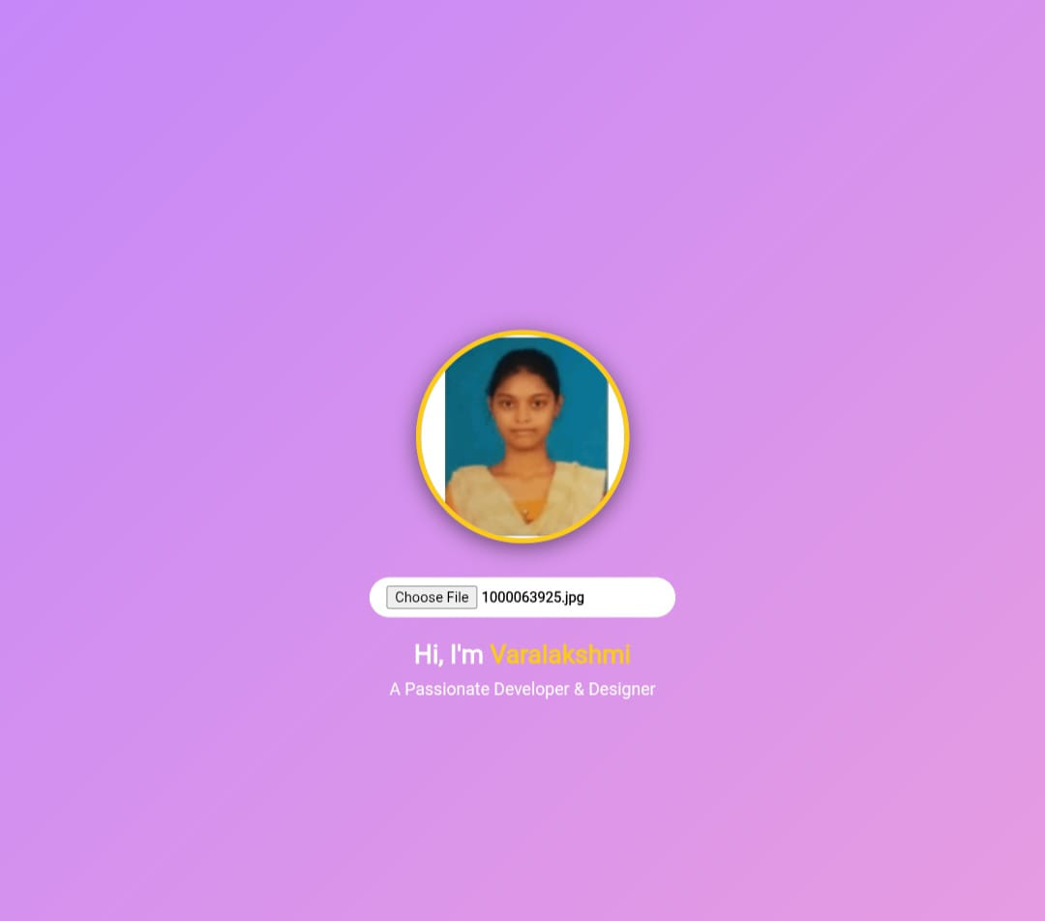

RESULTS AND SCREENSHOTS
3/21/2024 Annual Review
10

Slide 11
CONCLUSION
This digital portfolio successfully highlights education, skills, certificates, extracurricular activities, and achievements in an interactive way. It is live on GitHub Pages, easy to share, and helpful for future opportunities.
11

